Slide 1

Principal Components Analysis: Theory
(or, PCA as explained by beer!)
Social Epidemiology Course – March 4th, 2019
Daniel J Carter (he/him)
Research Fellow in Social Epidemiology
@methodsmandan
@LSHTM_TB

Slide 2
Methods Week
Learning methodology is often about revisiting the same concepts, deepening your understanding each time and connecting to big picture concepts
All my teaching materials, code for the practical sessions and a selection of papers I find useful on these topics are available on my github: https://github.com/danieljcarter/teaching
I will also hold an 'office hour' after Wednesday's lecture in G14 for any residual questions

Slide 3
Learning Objectives
(Hypothetically) you will:
☺ Have a conceptual and theoretical understanding of PCA
☺ Be able to read & understand an article that uses PCA
☺ Have looked at PCA in an out of Social Epi contexts
☺ Know when and why to use PCA
We will not cover:
► The linear algebra/mathematics behind PCA
► How to implement related techniques (e.g. MCA)

Slide 4
Beer: A Conceptual Introduction
Imagine that you get a new bartending job…
Boss: Sort through and summarise our 100-odd beers
“Your summary should be as simple but specific as possible”
You: No problem, I once had to sit through this lecture about PCA
Boss: PCA?
You: If I remember one thing from that lecture, it was:
PCA is a method of summarizing data that reduces its complexity, while still keeping the essential features of the data

Slide 5


A Visual Analogy
PCA is a method of summarizing data that reduces its complexity, while still keeping the essential features of the data

Slide 6
Back to Beer
Let’s say that you have information about:
Style of beer, brewery, country of origin, year of brewing, number produced, colour, price, alcohol content, bitterness, carbonation level, customer satisfaction
Clearly some of this information will be redundant (style of beer and colour probably are collinear, e.g. stout is collinear with black colour)
PCA makes new characteristics using the most ‘useful’ (i.e. not redundant) information from the data
These new characteristics are called linear combinations, and PCA finds the ‘best’ ones to summarise the data

Slide 7
Linear Combinations
What do we mean by ‘best’ linear combination
A linear combination that shows great variation across beers
Consider ‘contains alcohol’: not very useful
Call this maximizing variance
All data has variance (SD squared) which measures the spread of the data
A linear combination that allows us to best ‘reconstruct’ the original beer list
Consider ‘label colour’: not very useful
Call this minimising error
Luckily for us: maximising variance = minimising error

Slide 8
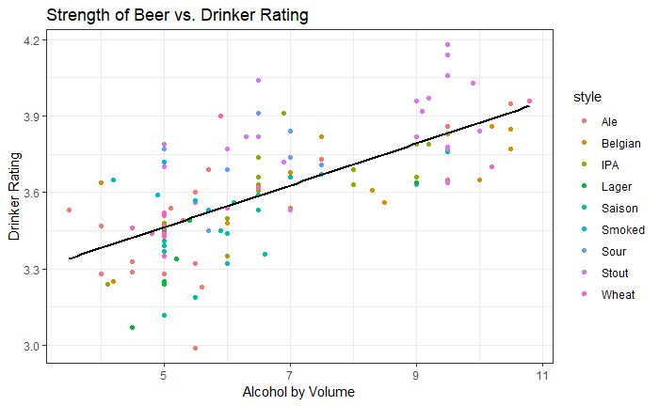
Simple Beer Example
Two potential beer properties that could be a summary score are alcohol content (ABV %) and average rating (Likert 1-5) from rate beer.

Slide 9
Simple Beer Example
This line of best fit maximises the variance and minimises the error so it is both a discriminatory and specific summary!

Slide 10
Principal Components
Note that the line of best fit is a linear combination of the two different beer properties Alcohol Content and Drinker Rating
We call this line the first principal component
When we draw a regression line, we essentially summarise the data down to its simpler linear structure
E.g. like the Son of Man analogy, we summarise a cloud of points with one line.
PCA is a method of summarizing data that reduces its complexity, while still keeping the essential features of the data

Slide 11
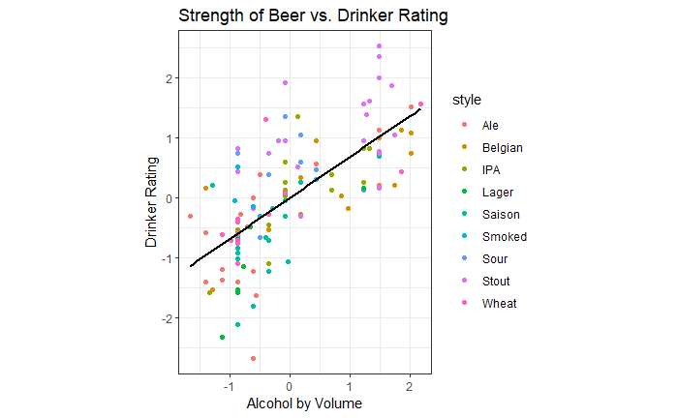
PCA in 5 Simple-ish Steps
STEP 1: Standardise
Center each variable at its mean and divide by the SD
Each variable now has: mean = 0 , variance = 1 (see also: z-score)
Ensures measurement scale doesn’t affect the result.

Slide 12

PCA in 5 Simple-ish Steps
STEP 2: Get Covariances & Variances
How does each variable vary within itself and with others?
Each variable contributes how much to total variance?
The below is the variance-covariance matrix. 0.683 is the correlation between the two variable and the slope of the best fit line.

Slide 13
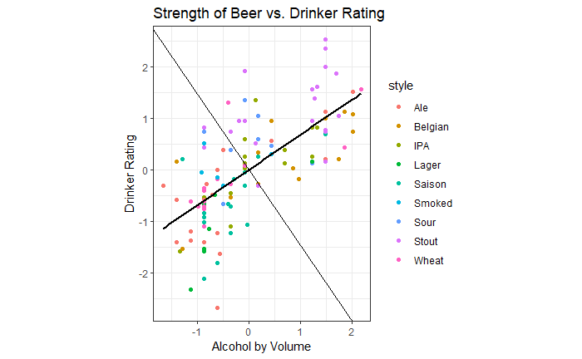
PCA in 5 Simple-ish Steps
STEP 3: Get eigenvectors and rotate
What is another name for these lines of best fit?
What is the light black line?
Rotate the data such that the ‘lines of best fit’ are the new axes

Slide 14

PCA in 5 Simple-ish Steps
STEP 3: Get eigenvectors and rotate
The eigenvectors represent how far we have to rotate the axes
Multiplying each point by the eigenvectors gives scores
Below are the eigenvectors from this data:

Slide 15
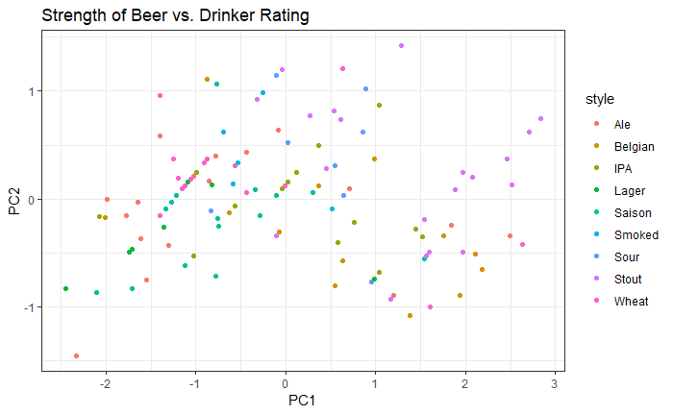
PCA in 5 Simple-ish Steps
STEP 3: Get eigenvectors and rotate
Scores:

Slide 16
PCA in 5 Simple-ish Steps
STEP 4: Get the eigenvalues
The eigenvalues represent how much variance each principal component accounts for
The eigenvalues for these data are EV1 = 1.68 and EV2 = 0.33, out of a total variance of 2.
Therefore, PC1 represents 84% of the total variance (and thus is a very good summary of the two properties!)

Slide 17
PCA in 5 Simple-ish Steps
STEP 5: Visualise and Interpret
We interpret PCA using ‘loadings’
Loadings are the eigenvectors rescaled by the eigenvalues
They are useful because they show us the correlation between each PC and each variable.
One way of visualising loadings is through a biplot:

Slide 18
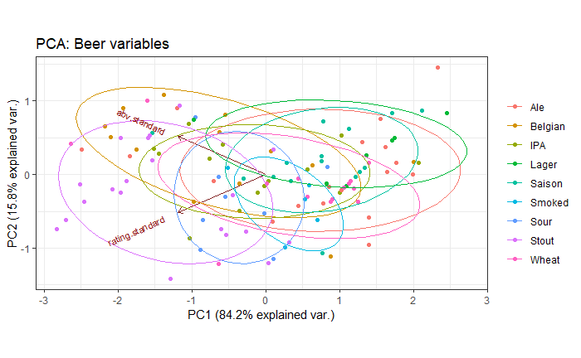
PCA in 5 Simple-ish Steps
Arrows = Loadings = point in direction of INCREASING variable values
Higher rating = low PC1 and Higher alcohol = low PC1
Summary score: low if a beer is well-regarded and high in alcohol

Slide 19
PCA in 5 Simple-ish Steps
Which beers should we expect to have low values of PC1?

Slide 20
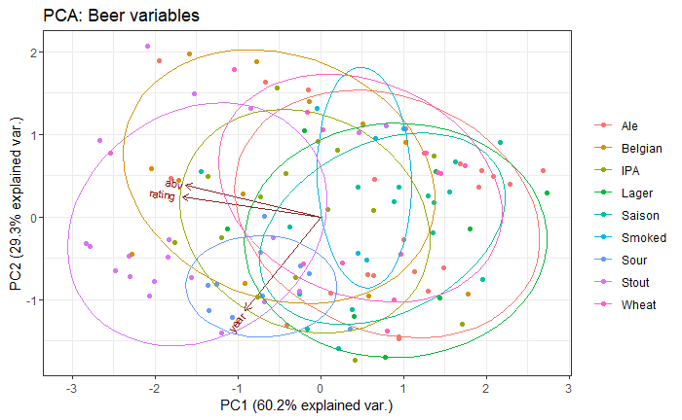
PCA in 5 Simple-ish Steps
Here is the biplot for the PCA when we add in ‘Year first brewed’

Slide 21
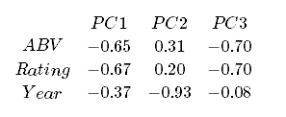
PCA in 5 Simple-ish Steps
Let’s interpret using the matrix of the loadings instead of the biplot this time.
What is the correlation between PC1 & Drinker Rating?
High PC1 = low alcohol content, low drinker rating, older years
Low PC1 = high alcohol, well-regarded, new beers – good summary score!
PC2 = newness; independent from being high alcohol & well-regarded
From eigenvalues (not shown): PC1 explains 60.2% of the variance.

Slide 22
A few comments
Reminder that the data and annotated R code for the beer example are available on my Github page/
You can and should work through this in your own time – remember that methodology takes repeated exposure so it’s OK if this all didn’t go in right away.
If in doubt, remember:
PCA is a method of summarizing data that reduces its complexity, while still keeping the essential features of the data

Slide 23

Questions??

Slide 24
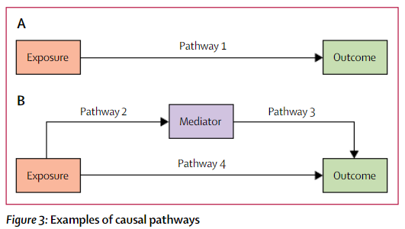
SDG 1 – Assessment for Mediation
Need to confirm our mediators are mediators
Pathway 1 decomposes into Pathway 4 and Pathway 2 + 3
If Pathway 4 is approximately 0 then Pathway 1 = Pathway 2 + 3

Slide 25
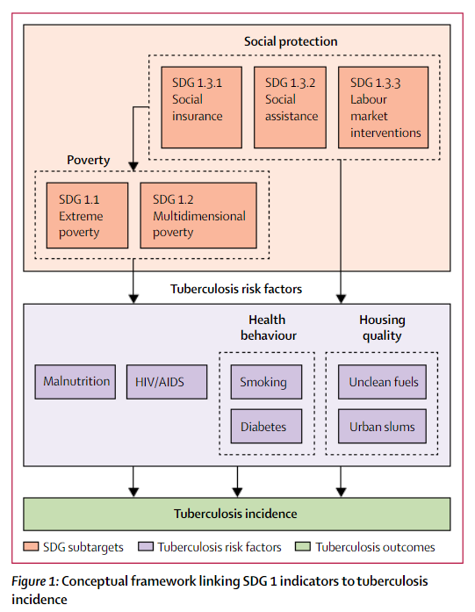
SDG 1 – Conceptual Framework
Initial conceptual framework has several mediators
Combined some risk factors into ‘composite measures’

